Slide 1
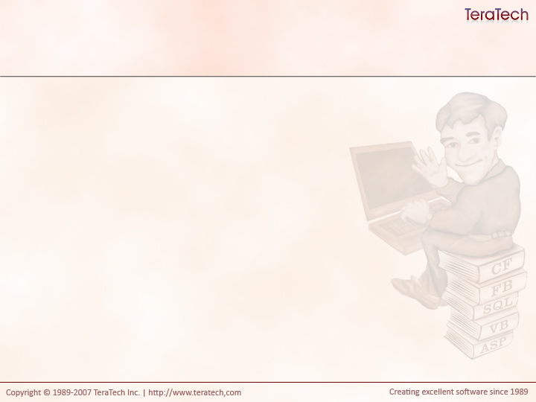
cfcUnit Crash Course
Automated testing is a Good Thing.

Slide 2
How do you test your code?
Q/A group?
Developer testing?
User feedback?
How well does it work for you?

Slide 3
The Cycle of a Bug
User reports bug
Developer fixes
the bug
Bug reemerges
Developer changes
something

Slide 4
The Solution
On every change, test everything you’ve ever changed before!
  How tedious, manual and error prone.
What if you could automatically test for every bug you’ve ever fixed?

Slide 5
Unit Testing To the Rescue
Individually test components
Write tests once and rerun tests on demand
Helps to insure changes introduce bugs
Helps insure new code works as expected

Slide 6
Porting Procedural Code to OO
Unit tests particularly helpful
  Write your tests first
  Port your code
  Run your tests

Slide 7
Test Driven Development
Write your tests first
Write your components
Expand your tests as needed
Keep running your tests
Write unit tests instead of .cfm scripts

Slide 8
cfcUnit
A unit test framework for ColdFusion
By Paul Kenny of Adobe
Best option out of two

Slide 9
Getting cfcUnit
Download from cfcunit.org
CVS
You should have been provided a copy

Slide 10
Installing the Framework
Copy /org to your webroot
  This is the testing framework’s model
Copy /cfcunit to your webroot (can’t make a mapping)
  This is the testing user interface
Note: The latest version has a showstopper bug!
  /org/cfcunit/service/TestListener.cfc
  Line 37, change type=“component” to type=“any”

Slide 11
Documentation
A few tutorials on cfcUnit.org
/cfcunit/documentation/index.html

Slide 12
Writing Tests
Setup your component
  Run for each test
Test each route through each function
Assert what you expect
Cleanup after yourself
  Run for each test
Notes:
Show an example TestFortune.cfc

Slide 13
Assertions (Abridged)
assertTrue(value, failureMessage)
assertFalse(value, failureMessage)
assertEqualsNumber(expected, actual, failureMessage)
assertEqualsDate(expected, actual, failureMessage)
assertEqualsArray(expected, actual, failureMessage)
assertEqualsBoolean(expected, actual, failureMessage)
assertEqualsString(expected, actual, failureMessage)
assertEqualsQuery(expected, actual, failureMessage)
assertEqualsStruct(expected, actual, failureMessage)
assertRegexMatch(regex, string, failureMessage)
fail(failureMessage)

Slide 14
Testing Gotchas
Each test function must start with “test”
Each test must be public

Slide 15
Running your test
Use HTML test runner
  http://localhost/cfcunit
  Enter fully qualified path to test

Slide 16
cfcUnit, Ant, and Eclipse (oh my!)
You can use Ant to run cfcUnit Tests
You can run Ant scripts from Eclipse
You can run cfcUnit tests from Eclipse!

Slide 17
Running Unit Tests in Eclipse
Required ant-cfcunit.jar
Use taskdef to tell Ant where to find this file:
  <taskdef resource="org/cfcunit/ant/antlib.xml">
  <classpath>
  <pathelement location="cfcunit/lib/ant-cfcunit.jar"/>
  </classpath>
  <taskdef>
Disable debugging output in your tests
  <cfsetting showdebugoutput="false" />
Right click on Build.xml > Run As > Ant task
Reports shown in Eclipse console

Slide 18
cfcUnit Ant Task Documentation
/cfcunit/documentation/ant_task.html

Slide 19
Automatic Testing in Eclipse
Right click on project
Click builders and click new
Select And Build and click Ok
Select Build.xml file
Click Targes Tab
Click Autobuild and select the Target to run
Click Ok

Slide 20
Exercise
Write a unit test for your fortune cfc
Run it via the test runner interface
Run your tests in Eclipse
Configure your tests to run automatically

Slide 21
Let’s Talk
What’s your take on unit tests?
Which would you rather do? Visit the dentist or write unit tests?
How can this help you port old code?

